Slide 1
BI Analysis Week 3
Shawna Tuli (Shawna.tuli@avanade.com)

Slide 2
Agenda
Jupyter Notebooks
Virtual Environments
Integrated development environments (ides)

Slide 3

Jupyter Notebooks

Slide 4

Steps
Download Anaconda or pip3 install jupyter in Terminal or PowerShell.
Create your first notebook by selecting “New” then “Python 3(ipykernel).”
Name your notebook and save it.
Make code and Markdown cells.
Write Python, R, Julia, Scala, C++, Java, Bash, C#, HTML, CSS, JavaScript, PHP, and/or SQL code.
Run cells to generate output.
Save your notebook and export it with “File” then “Download as.”

Slide 5
Magic Commands
Magic Command | What it does
%run | Runs an external script file as part of the cell being executed. For example, if %run myscript.py appears in a code cell, myscript.py will be executed by the kernel as part of that cell.
%timeit | Counts loops, measures and reports how long a code cell takes to execute.
%writefile | Save the contents of a cell to a file. For example, %savefile myscript.py would save the code cell as an external file called myscript.py.
%store | Save a variable for use in a different notebook.
%pwd | Print the directory path you're currently working in.
%%javascript | Runs the cell as JavaScript code.
Notes:
https://www.dataquest.io/blog/jupyter-notebook-tutorial/

Slide 6
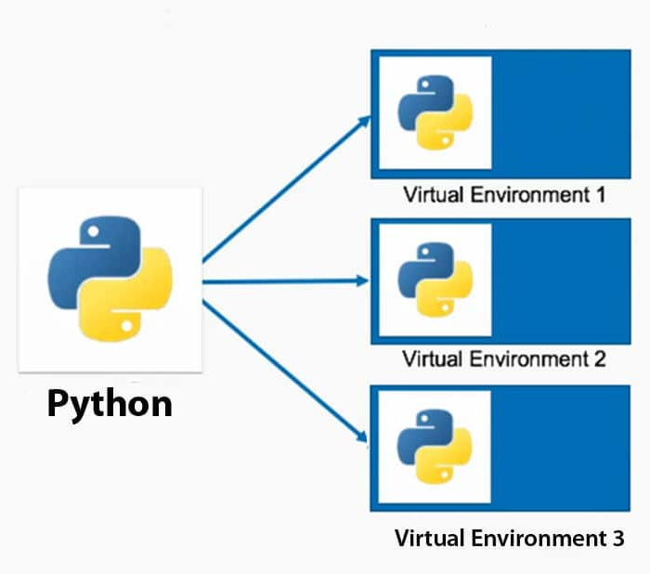
Virtual Environments

Slide 7
About
A virtual environment is (amongst other things):
Used to contain a specific Python interpreter and software libraries and binaries which are needed to support a project (library or application). These are by default isolated from software in other virtual environments and Python interpreters and libraries installed in the operating system.
Contained in a directory, conventionally named .venv or venv in the project directory, or under a container directory for lots of virtual environments, such as ~/.virtualenvs.
Not checked into source control systems such as Git.
Considered as disposable – it should be simple to delete and recreate it from scratch. You don’t place any project code in the environment.
Not considered as movable or copyable – you just recreate the same environment in the target location.
Notes:
The venv module supports creating lightweight “virtual environments”, each with their own independent set of Python packages installed in their site directories. A virtual environment is created on top of an existing Python installation, known as the virtual environment’s “base” Python, and may optionally be isolated from the packages in the base environment, so only those explicitly installed in the virtual environment are available.
When used from within a virtual environment, common installation tools such as pip will install Python packages into a virtual environment without needing to be told to do so explicitly.

Slide 8
python -m venv /path/to/new/virtual/environment
Platform | Shell | Command to activate virtual environment
POSIX | bash/zsh | $ source <venv>/bin/activate
 | fish | $ source <venv>/bin/activate.fish
 | csh/tcsh | $ source <venv>/bin/activate.csh
 | pwsh | $ <venv>/bin/Activate.ps1
Windows | cmd.exe | C:\> <venv>\Scripts\activate.bat
 | PowerShell | PS C:\> <venv>\Scripts\Activate.ps1
Notes:
https://docs.python.org/3/library/venv.html

Slide 9




Integrated Development Environments (IDEs)

Slide 10
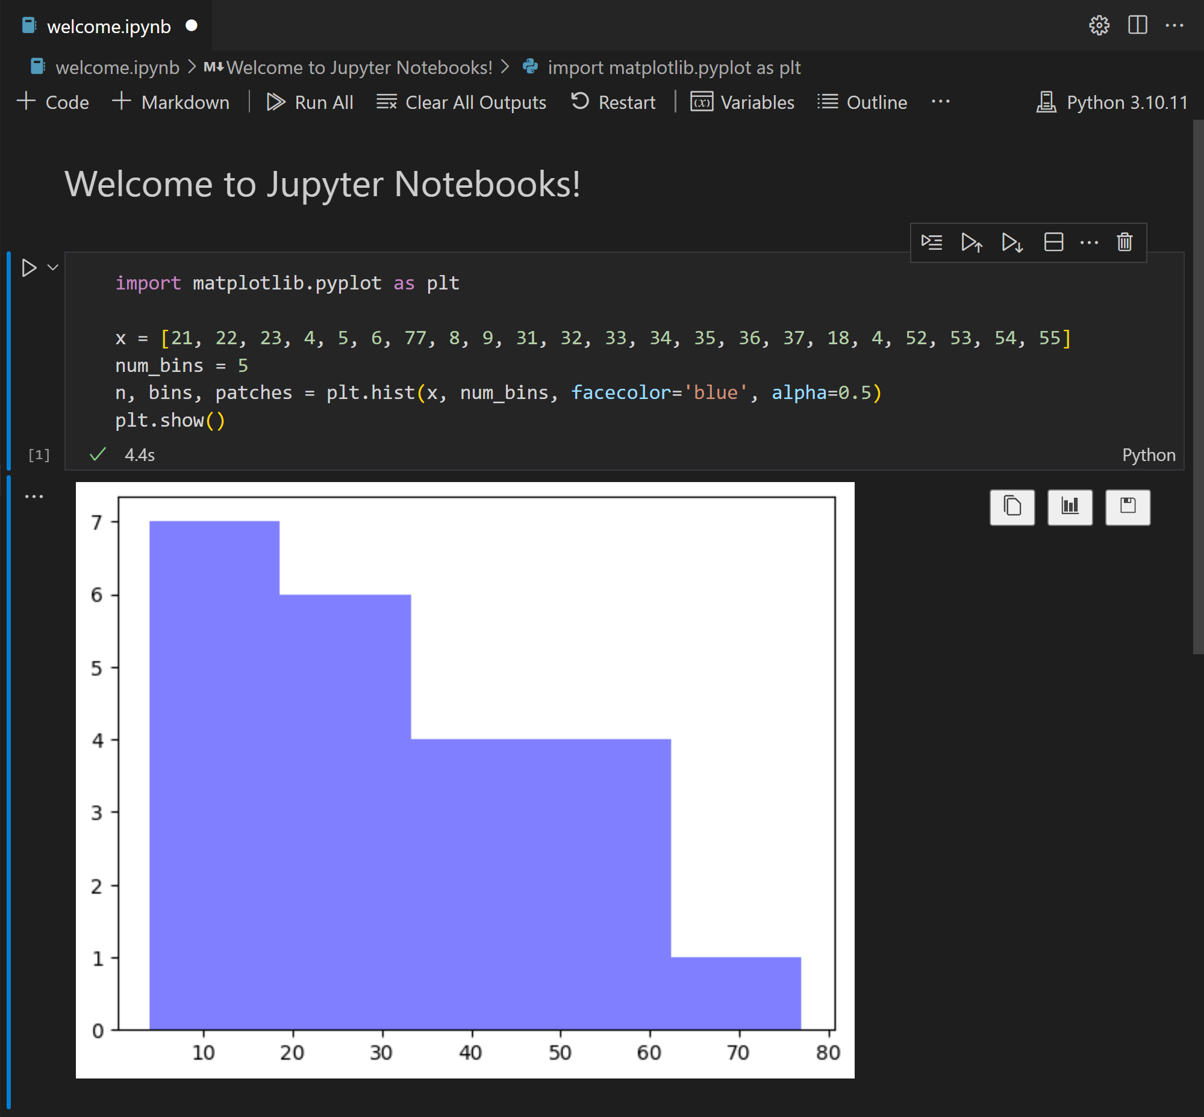
Visual Studio / Visual Studio Code
Notes:
https://code.visualstudio.com/docs/datascience/overview

Slide 11
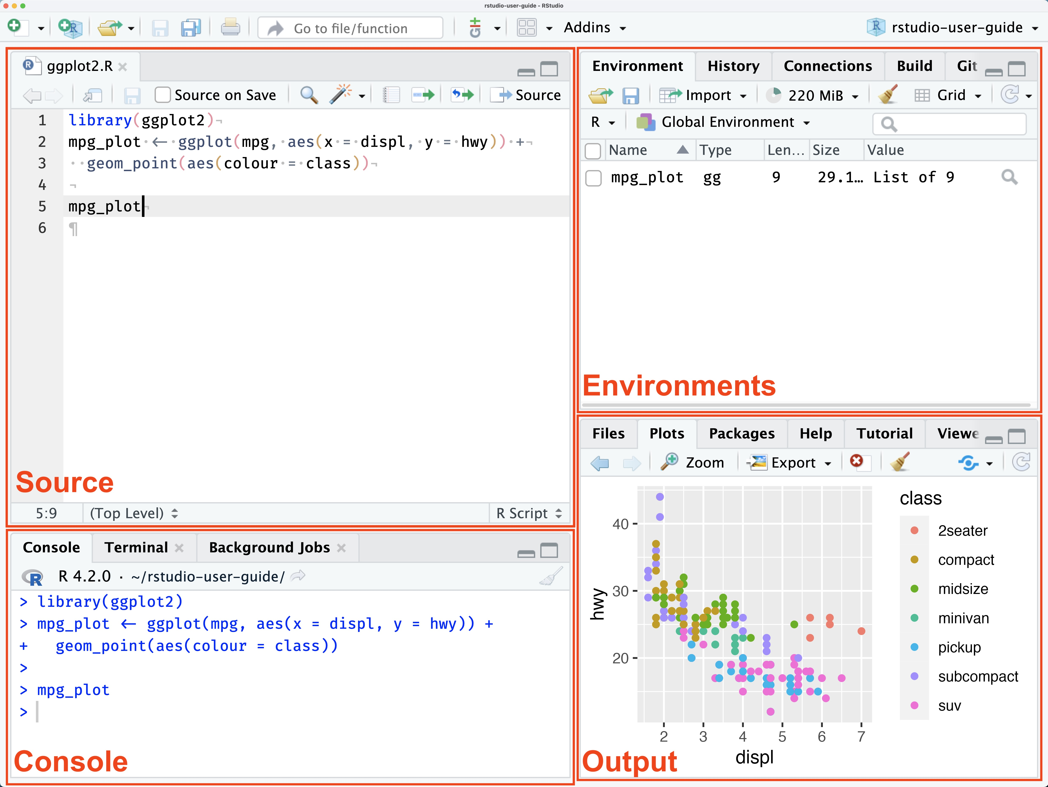
RStudio
Notes:
https://docs.posit.co/ide/user/ide/get-started/

Slide 12
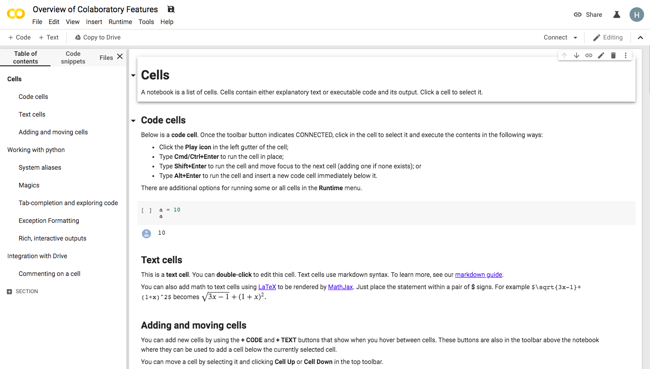
Google Colab
Notes:
https://afzalbadshah.com/index.php/2024/02/26/introduction-to-google-colab/

Slide 13
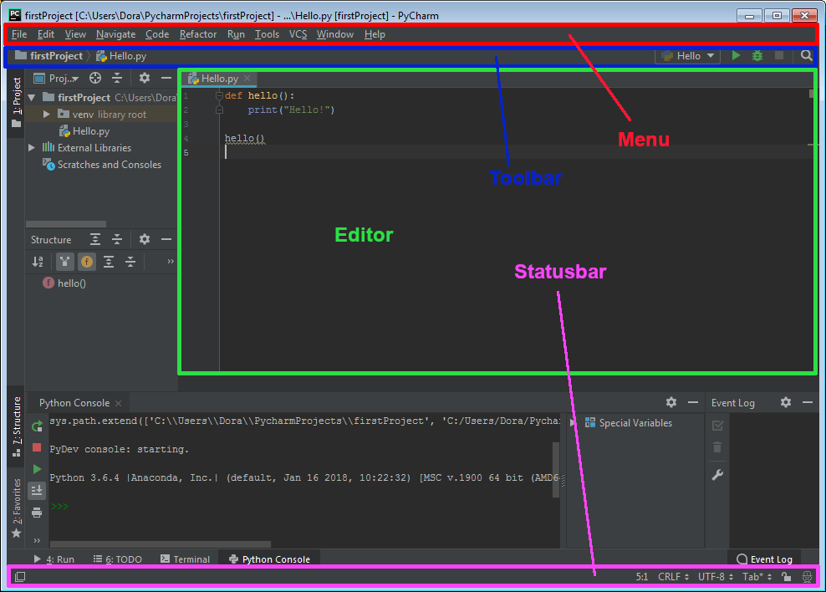
PyCharm

Slide 14
Timeline

Slide 15
Program
Kick-Off
Students will be meet their teams and begin planning their project
4 Workshops
Students will attend guided workshops covering key tools used in data science projects
Help Sessions
Data@UCI will provide mini help sessions following the end each workshop
Final Presentations
Groups will have the opportunity to present their projects and win prizes

Slide 16
Week | Timeline
Week 1 (1/6-1/12) | Regular Event: Info Session for Mentees
Week 2 (1/13 - 1/19) | Regular Event : Project Kick-Off
Week 3 (1/20 - 1/26) | Thursday - Workshop 1: Tour of Notebooks/Environments/IDEs + Help Session
Week 4 (1/27-2/2) | Thursday - Workshop 2: Data Exploration (Pandas & Feature Selection) + Help Session
Week 5 (2/3 - 2/9) | Thursday - Workshop 3: Machine Learning (Scikit-Learn & Model Evaluation) + Help Session
Week 6 (2/10 - 2/16) | Thursday - Collaboration with Design@UCI (tentative + midterms)
Week 7 (2/17 - 2/21) | Thursday - Workshop 4: Data Visualization (Power BI or similar) + Help Session
Week 8 (2/24 - 3/1) | Thursday - Final Winter Project Help Session
Week 9 (3/3 - 3/9) | Thursday - Final Presentations

Slide 17
Deliverables

Slide 18
Week | Deliverable
Week 1 (1/6-1/12) | Commitment
Week 2 (1/13 - 1/19) | Meeting Series
Week 3 (1/20 - 1/26) | Jupyter Notebooks
Week 4 (1/27-2/2) | Exploratory Data Analyses
Week 5 (2/3 - 2/9) | Machine Learning
Week 6 (2/10 - 2/16) | Design
Week 7 (2/17 - 2/21) | Data Visualization
Week 8 (2/24 - 3/1) | Presentation
Week 9 (3/3 - 3/9) | Final Presentation

Slide 19
Thank you!

